Slide 1
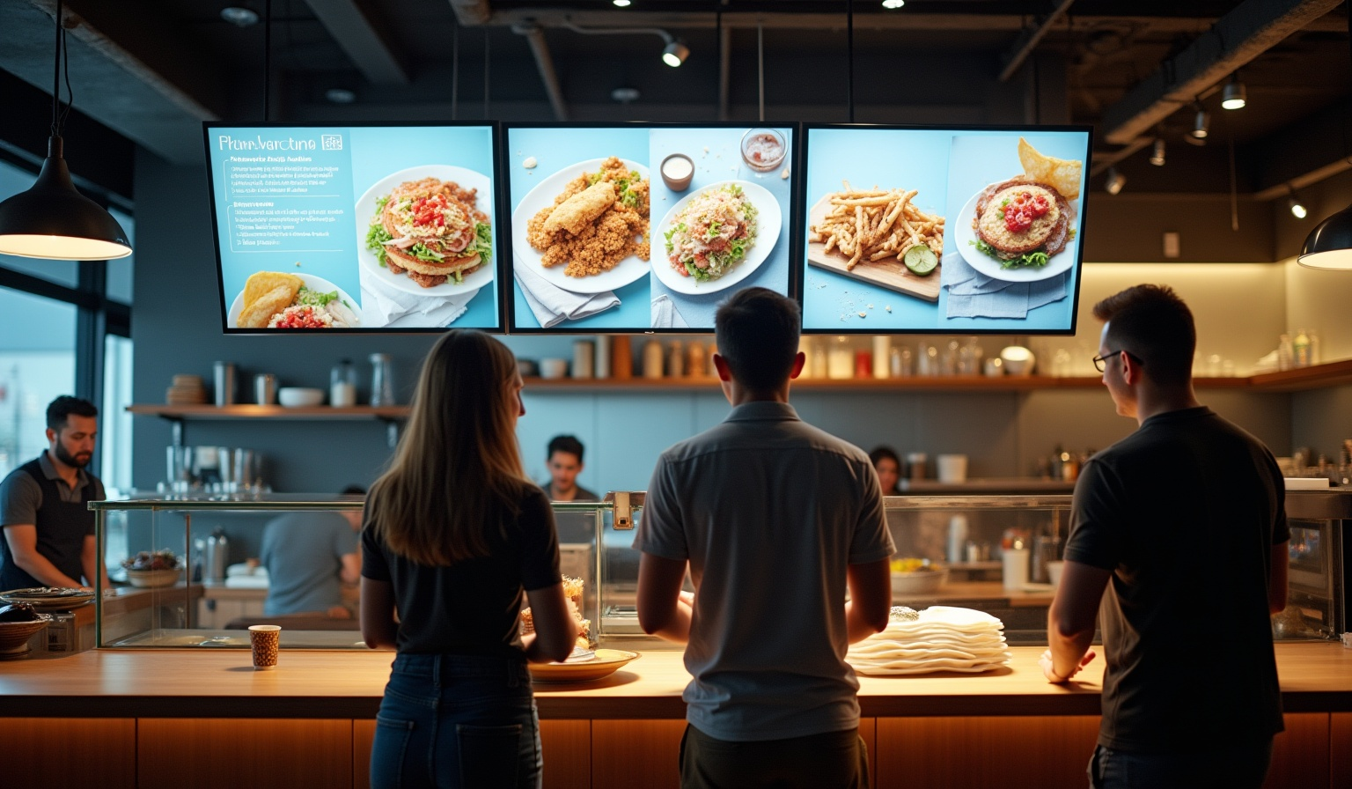
Digital Menu for Canteens
Streamlining Ordering and Payment Processes
By - P. Janapriyanka
P. Monisha

Slide 2
INTRODUCTION
In today’s fast-paced environment, canteens often face challenges such as long queues, manual billing errors, and delays in order processing. The Digital Menu System for Canteen is a Java-based application designed to simplify and speed up the ordering process. This system allows customers to view the menu, place orders, and make payments seamlessly using a QR code. It also enables the canteen staff to manage menu items and orders efficiently. By integrating Java, MySQL database, and QR code technology, the project provides a modern, contactless, and efficient solution for canteen operations.

Slide 3
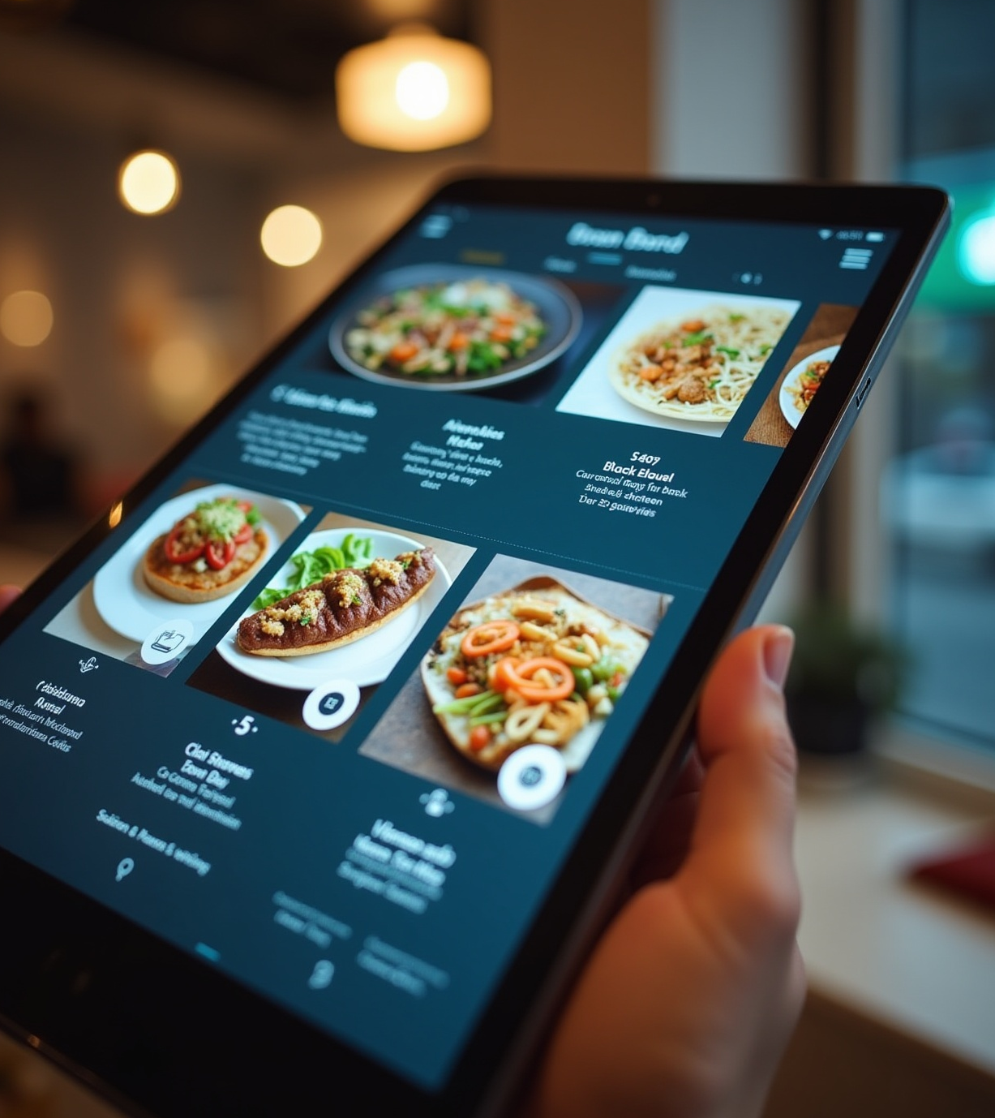
PROBLEM STATEMENT
In many canteens, the traditional ordering process involves manual menu display, handwritten orders, and cash transactions. This approach often leads to: Long queues and slow service during peak hours Calculation errors in billing Difficulty in updating menu items and prices Lack of contactless payment options, which is important for convenience and hygiene

Slide 4
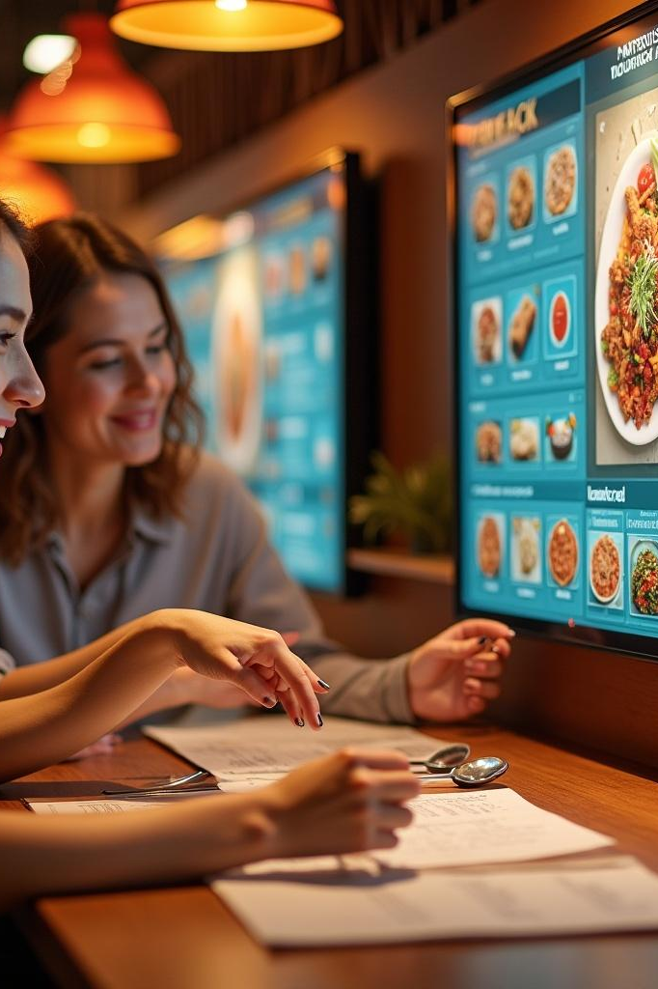
OBEJECTIVES
To automate the canteen ordering process using a Java-based application
To display a real-time digital menu from a database
To calculate the total bill automatically and accurately
To generate a UPI-based QR code for quick and contactless payment
To reduce order processing time and human errors
To provide an easy way for staff to update menu items and prices

Slide 5
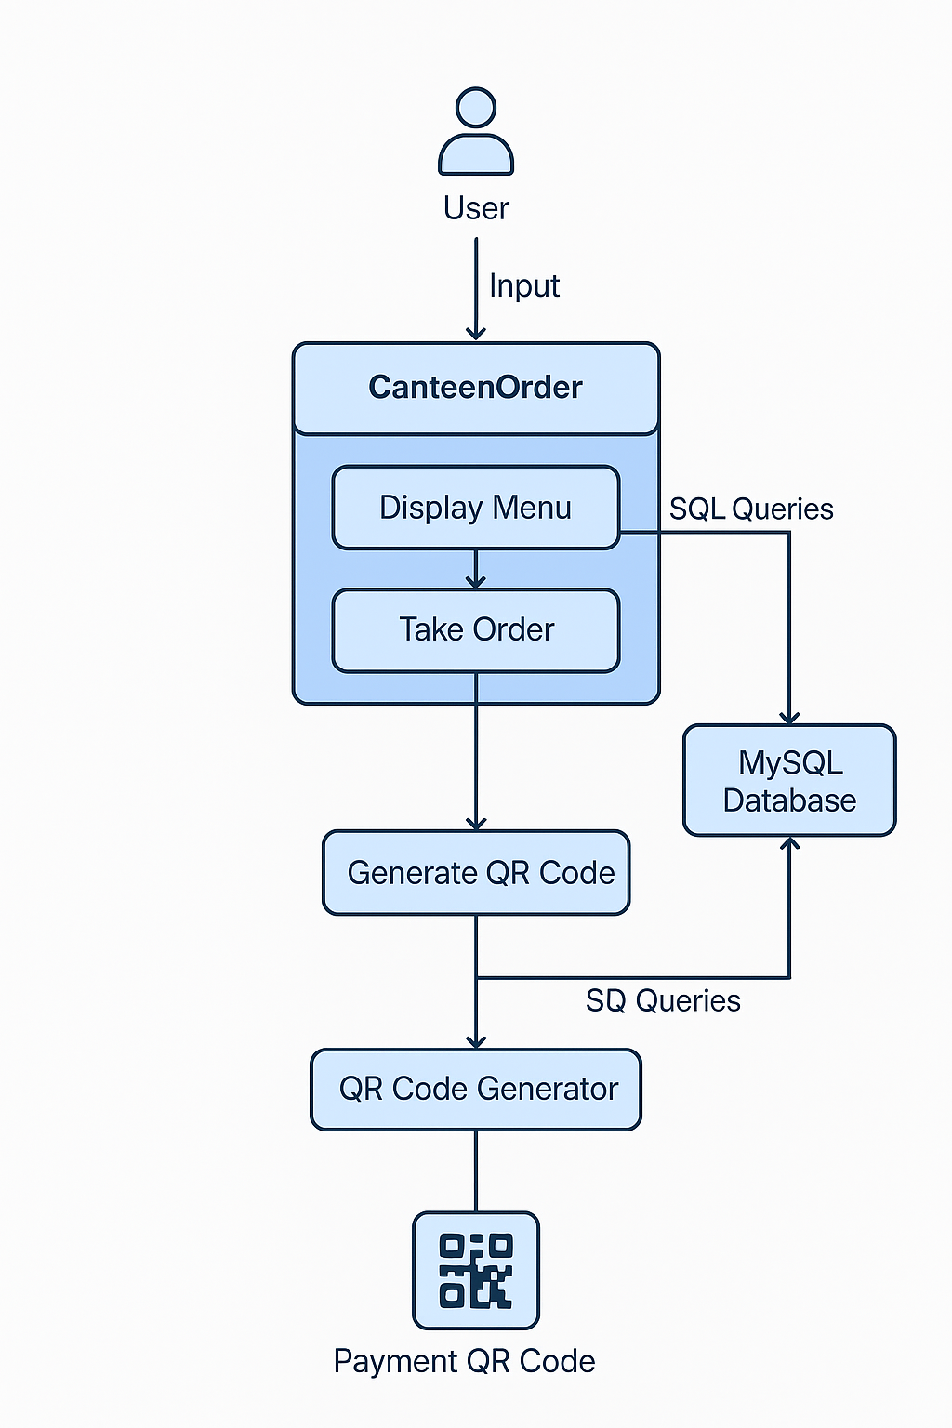
STRUCTURE OF DIGITAL MENU

Slide 6
TECHNOLOGIES USED
Programming Language: Java
Database: MySQL Database
Connectivity: JDBC (Java Database Connectivity)
QR Code Generation Library: ZXing (Zebra Crossing)
Development Environment: Eclipse
IDE Payment Method: UPI payment link embedded in QR code
Java Concepts: OOP, Collections, Exception Handling, File Handling

Slide 7
MODULES USED
Menu Display Module
Order Processing Module
QR Code Generation Module
Payment Confirmation Module
Database Module

Slide 8
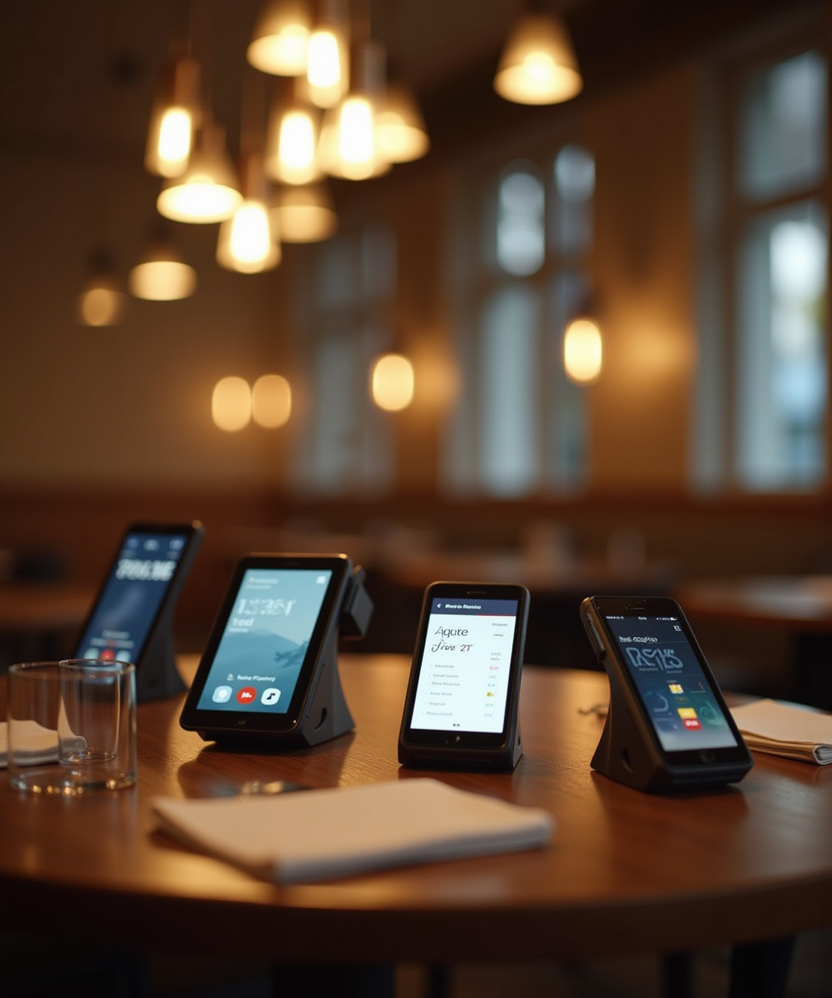
JAVA CONCEPTS IMPLEMENTED
1. Object-Oriented Programming (OOP) 2. JDBC (Java Database Connectivity) 3. Collections Framework 4. Exception Handling 5. File Handling 6. External Libraries

Slide 9
ADVANTAGES
Faster Service – Reduces waiting time in queues
Error-Free Billing – Automatic calculation of total price
Contactless Payment – Secure UPI QR code transactions
Easy Menu Updates – Database-based menu management
Improved Efficiency – Streamlined order processing for staff
Customer Convenience – Simple and quick ordering process

Slide 10
FUTURE ENHANCEMENT
Develop a mobile application for ordering on the go
Add online pre-ordering to reduce peak-hour congestion
Integrate online payment gateway for automatic payment confirmation Implement a customer feedback & rating system
Add real-time order tracking for customers
Enable multi-language support for better accessibility

Slide 11
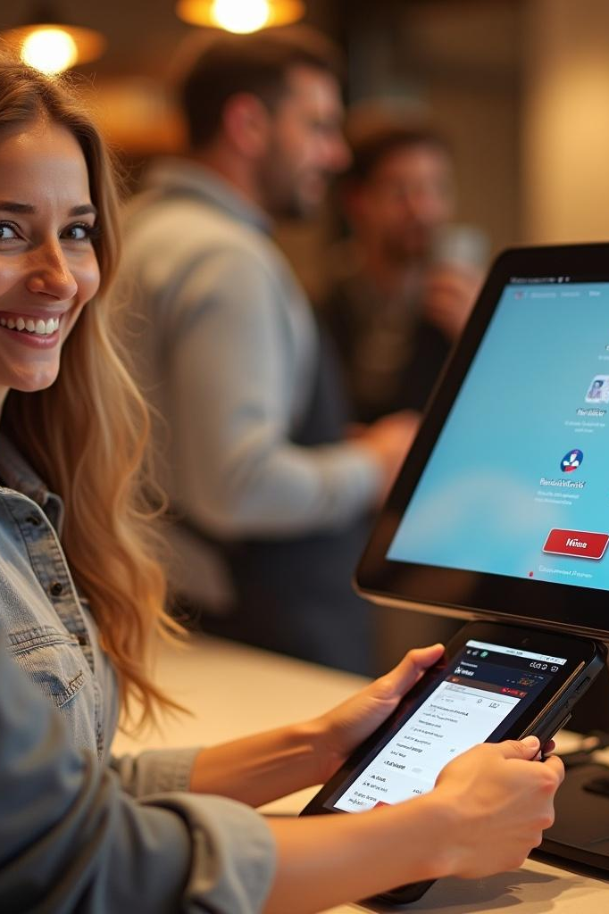
CONCLUSION
The Digital Menu System improves canteen efficiency by automating menu display, order processing, and payment.It minimizes manual errors and reduces customer waiting time.The integration of Java, MySQL, and QR code technology makes the system reliable and easy to use.This project demonstrates how simple technology solutions can create a faster, contactless, and more convenient ordering experience for both customers and staff.

Slide 12
THANK YOU

